Slide 1
CO2 Emission Study
By
Smita Khapre

Slide 2
What is CO2 Emission
CO2 emission is refered to as the emission of CO2 gas from burning oil, coal and gas to the energy requirements.
These are mostly generated burning the fossil fuels
CO2 is also called green house gas as it traps the heat in the atmosphere
Its is the main cause of global warming

Slide 3
Why CO2 Emission is increasing
With the advancements in technology, energy requirements is increasing.
With increased energy requirement fossil fuel consumption is increasing
Thus mining, and other methods of fossil fuel extraction is also increasing.
Thus combustion of fossil fuel is increasing
Thereby increasing the CO2 emissions

Slide 4
Global Warming
Main cause of Global Warming is increased levels of CO2 emissions in the atmosphere
Global warming caused
Polar Ice melting
Rise in sea level
Extreme weather phenomena
Irreversible damages due to floods, droughts, tornadoes, Blizzards and so on
It also causing drastic effect of ecological balance

Slide 5
SOLUTION APPROACH
CO2 emission needs to be reduced.
International Energy Association (IEA) examines the full spectrum of energy issues including oil, gas and coal supply and demand, renewable energy technologies, electricity markets, energy efficiency, access to energy, demand side management and much more.
Data analysis taken from IEA would help us understand the issue in different spectrum And would give us the outlier needs to be treated differently.

Slide 6
DATA AND DATA SOURCE
Data source - www.iea.org/publications/freepublications/publication/CO2-emissions-from-fuel-combustion-highlights-2017.html
Data is extracted to following files for Machine leaning and data Analysis:
CO2 emissions total and different sectors – Refer to https://github.com/smitakh/Coursera_capstone/blob/master/CO2FC_90.csv
Population – Refer to https://github.com/smitakh/Coursera_capstone/blob/master/POP_90.csv
GDP – Refer to https://github.com/smitakh/Coursera_capstone/blob/master/GDP_90.csv
Per Capita CO2 emissions Population – Refer to https://github.com/smitakh/Coursera_capstone/blob/master/CO2POP_90.csv
Per Capita CO2 emissions sector-wise - – Refer to https://github.com/smitakh/Coursera_capstone/blob/master/SECTOR.csv https://github.com/smitakh/Coursera_capstone/blob/master/SECTPOP.csv

Slide 7
Methodology
Choropleth mapping shows the CO2 emission spread in different countries.
Scatter plot visualization for checking if we have outliers
Data Wrangling, Standardization and Normalization
K-Mean Clustering based on CO2 emissions, Population, GDP and per capita CO2 emission
Four Square APIs to check on one of the maximum CO2 emission per capita on the venues available and see if it shows any pointing to fuel combustion industries

Slide 8
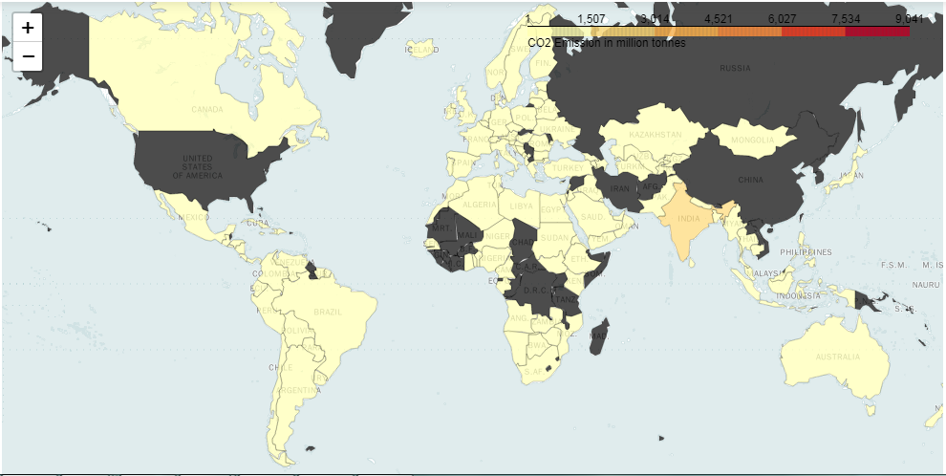
Choropleth Map of CO2 emission
Country-wise CO2 emission mapping

Slide 9
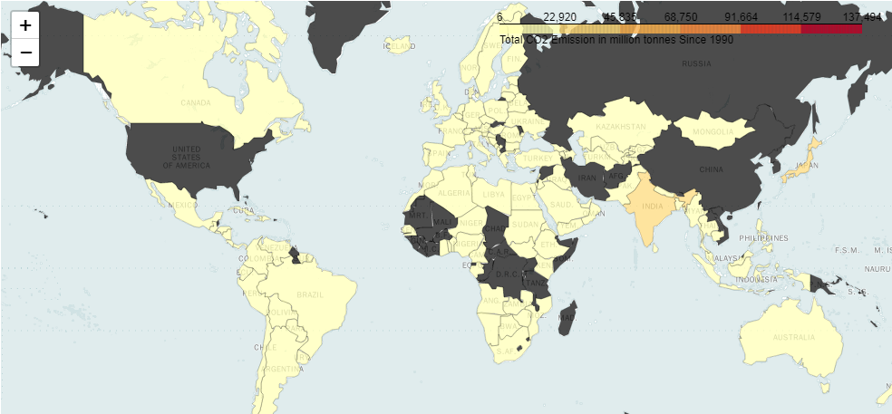
Choropleth Map Contd…
Country-wise GDP mapping

Slide 10
Choropleth Map Contd…
Dark shaded countries are the main source of CO2 emissions
There is a need to understand the population, GDP and per Capita emissions for these countries.
Most of the other lighter shaded one neither have considerable CO2 emissions nor GDP/POP.
But some of the lighter shades countries do have very high per capita emissions, which is evident in further studies

Slide 11
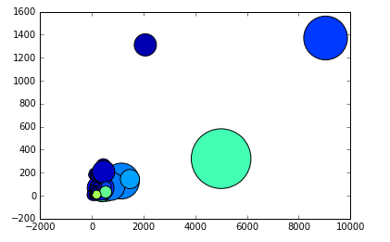
Scatter Plot
Three outlier countries are shown

Slide 12
K-Means Clustering
We have 146 countries across the globe for which we have available data
When we cluster in 6 segments we find three outliers namely China, US and Japan
Two segments with 6 and 9 countries
France, Germany, Italy, United Kingdom, India and Brazil
Russia, Korea, Canada, Mexico, Indonesia, Australia, Spain, Turkey and Netherlands
One common segment where remaining 128 of 146 countries are clustered

Slide 13
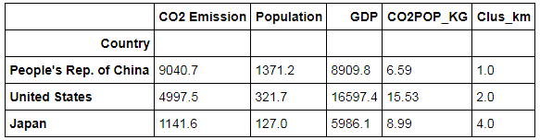
K-Means Clustering Contd…
If you notice these outliers, we see Very high GDP of US, China and Japan but Very high CO2 emissions for China and US only.
Thus we can strike out Japan from the Focus group for CO2 emissions reduction target

Slide 14
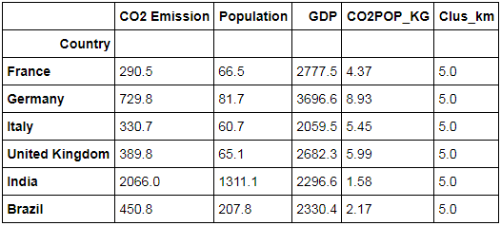
K-Means Clustering Contd…
Looking at above segment, only India is shown to have high CO2 emissions, but with very low per capita CO2 emissions.
Thus, this segment is also out of the targeted CO2 emissions reduction

Slide 15
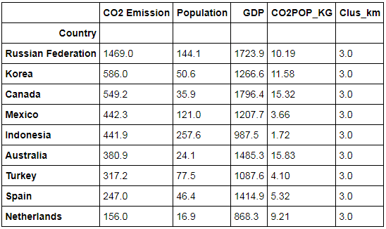
K-Means Clustering Contd…
All of these countries show low CO2 emissions
But Australia, Russia, Korea, Canada, Netherlands show very high per capita CO2 emissions

Slide 16
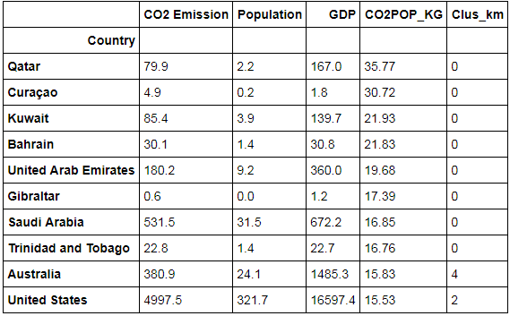
Per Capita CO2 emissions
While top 9 countries here have low overall CO2 emissions and even if they reduce little given extreme climatic condition would be insignificant globally

Slide 17
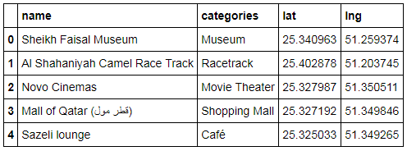
Four Square API
Lets try to see the venues in Highest per capita CO2 emissions
It does not show any significant venue which might cause significant CO2 emissions

Slide 18
Conclusion
China and United States definitely stands out against entire world
It caused nearly 43% of entire world’s emission.
They also contributed to 33% of worlds GDP
We can conclude that the best way is to discourage the fossil fuel consumption for energy requirements
And encourage the green energy productions at all sectors to reduce the CO2 emissions to solve global warming

